Slide 1
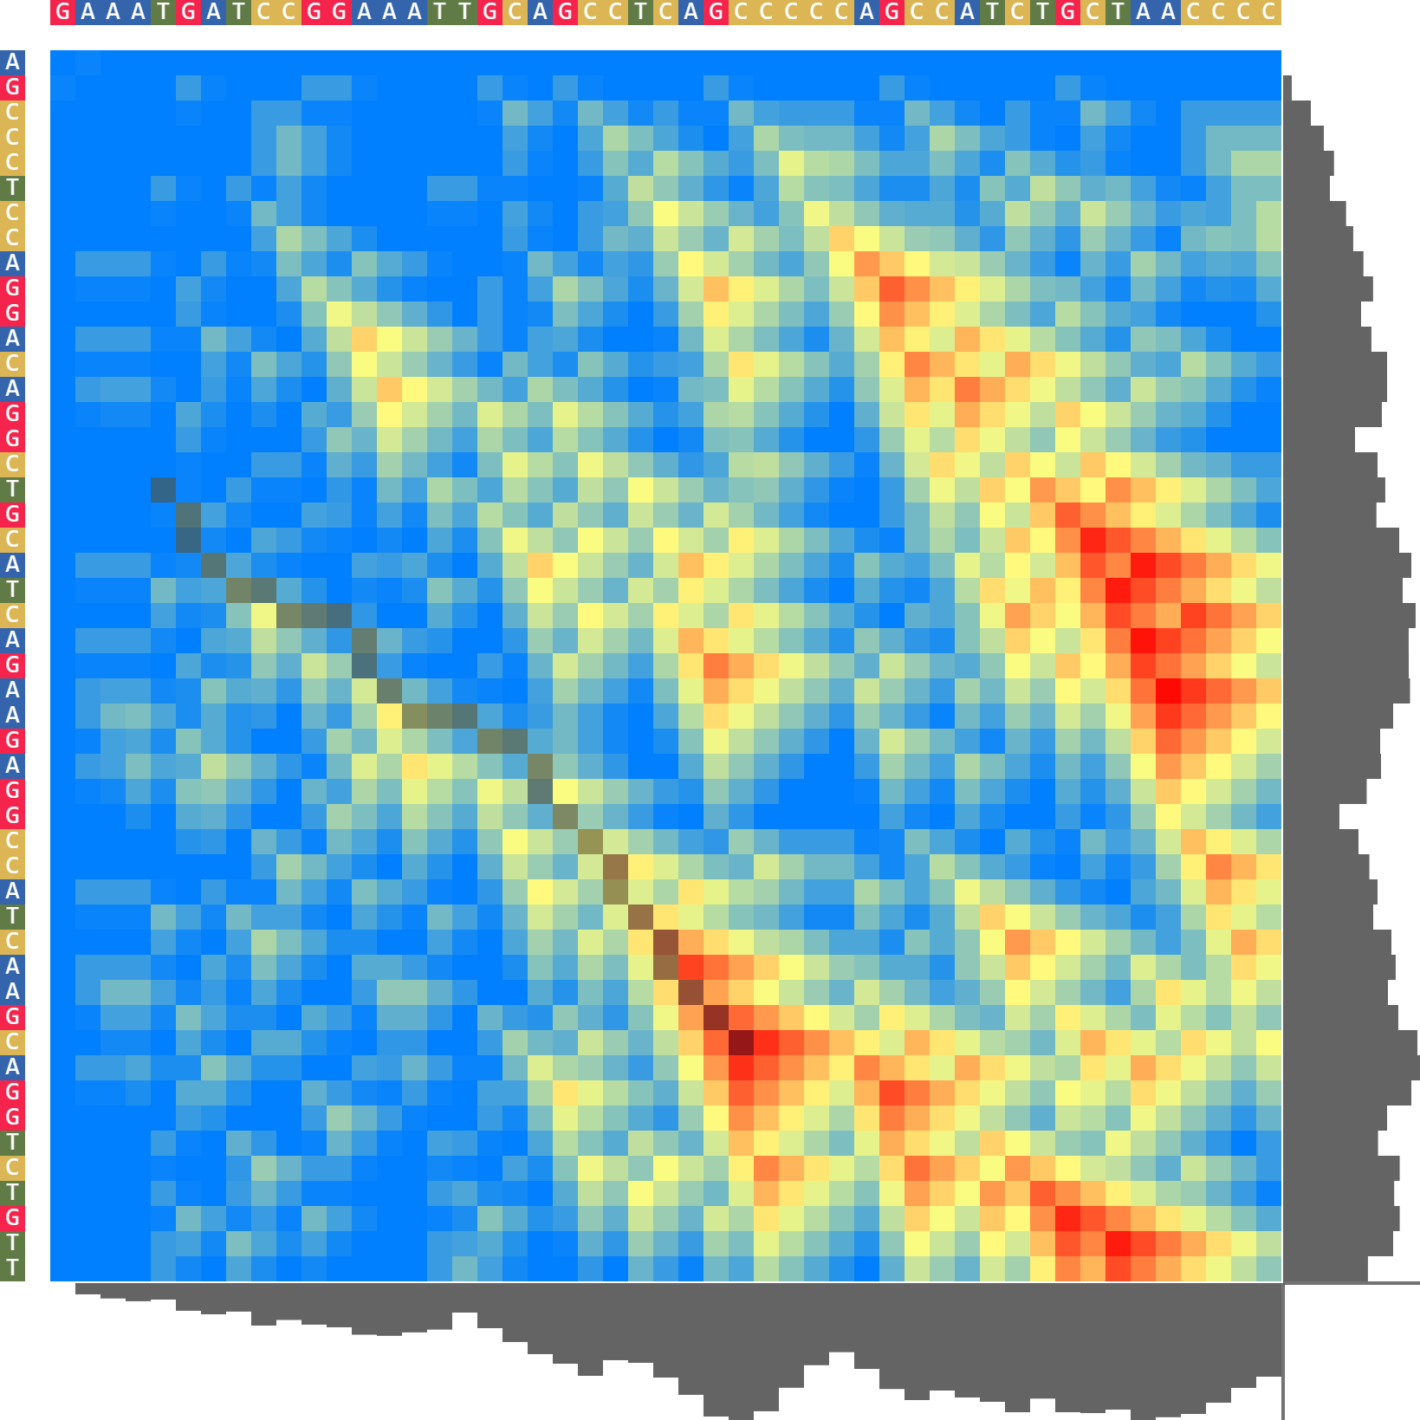
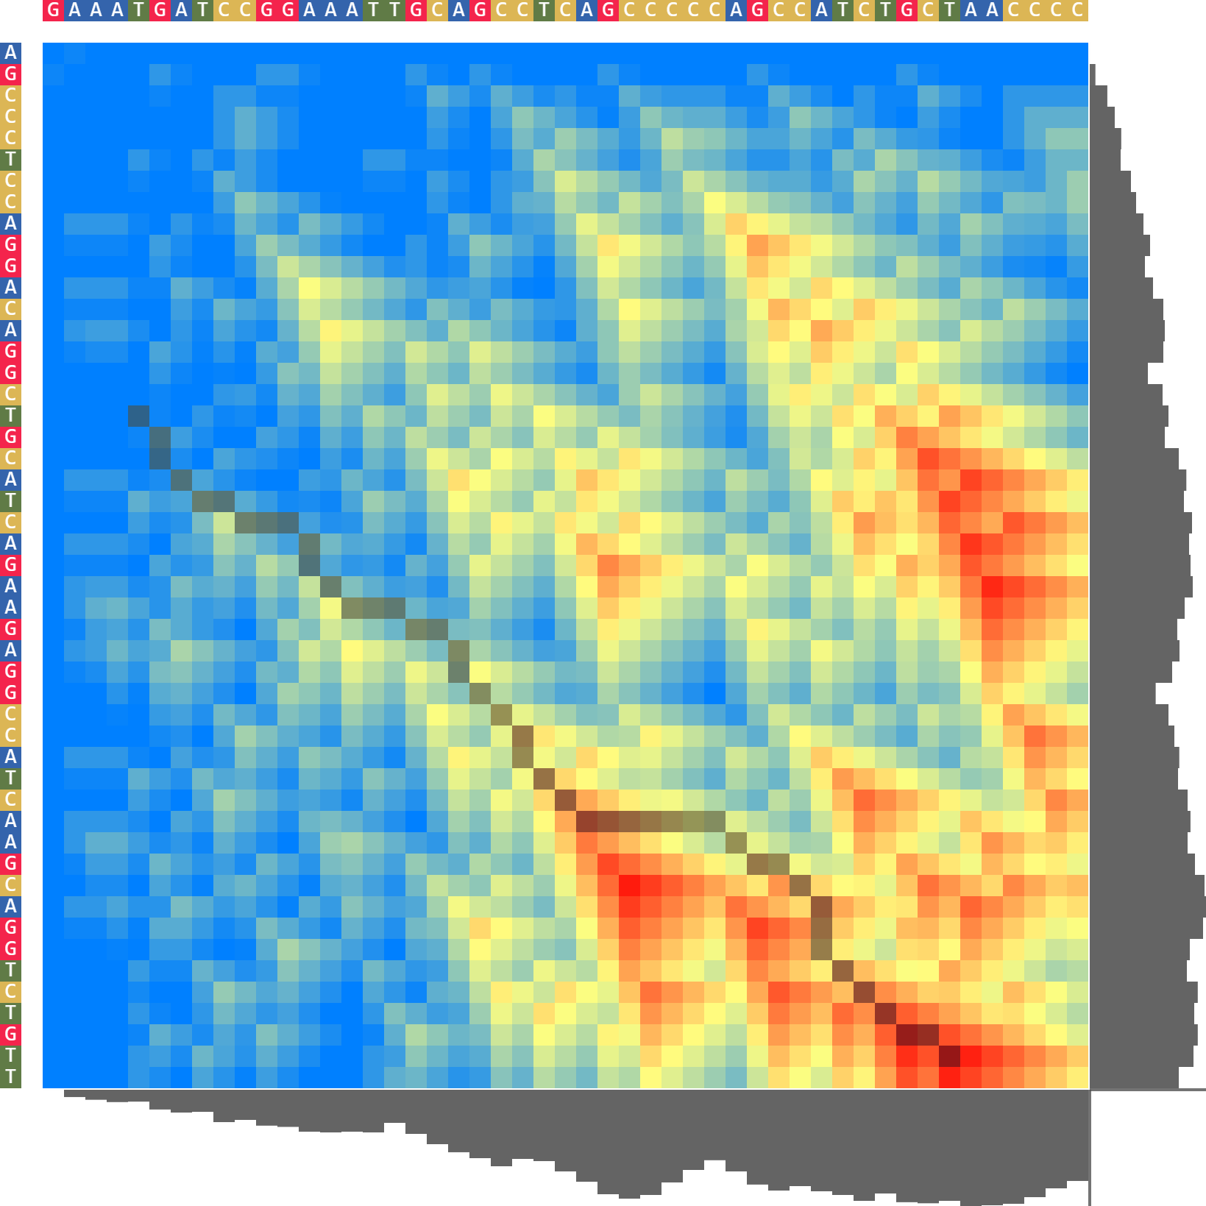
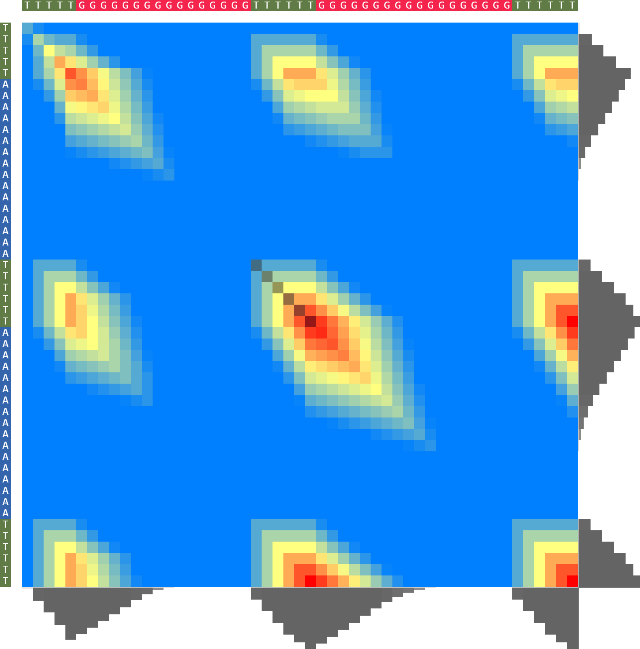
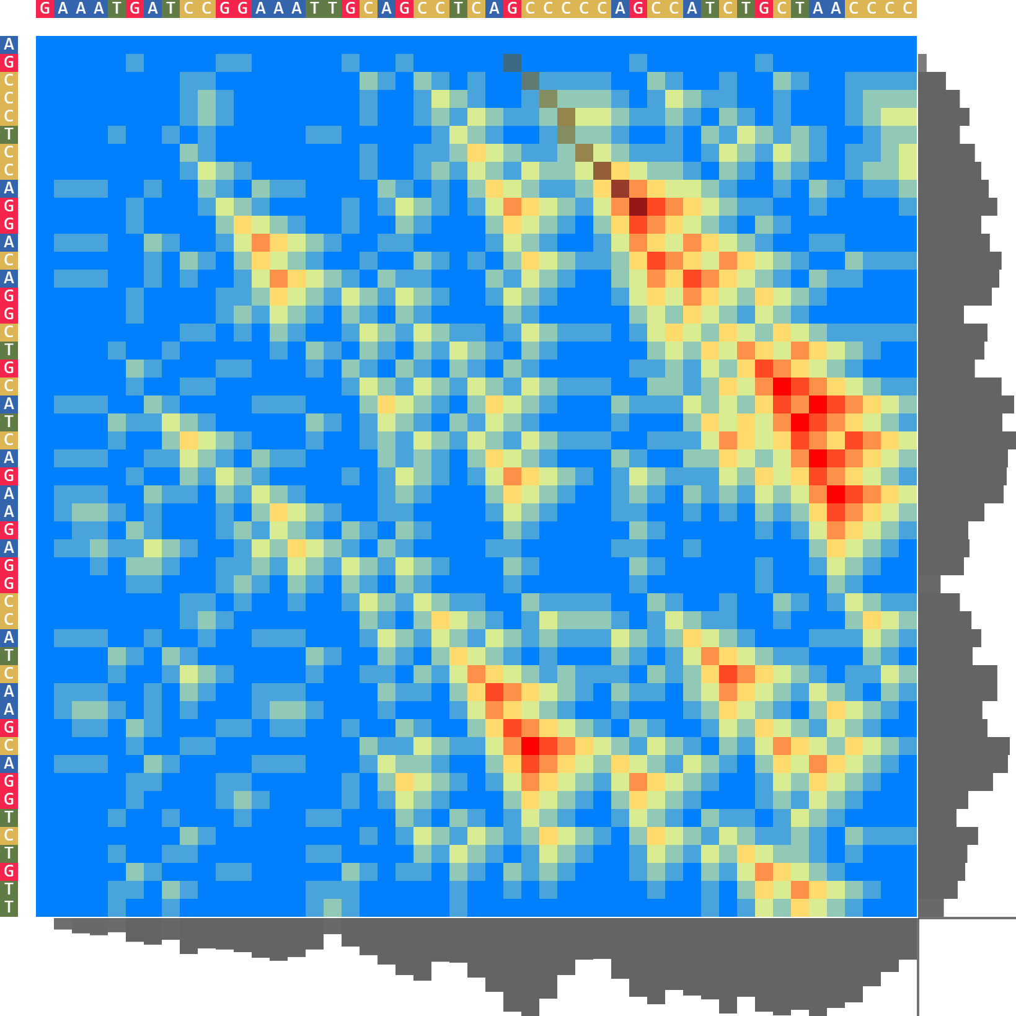
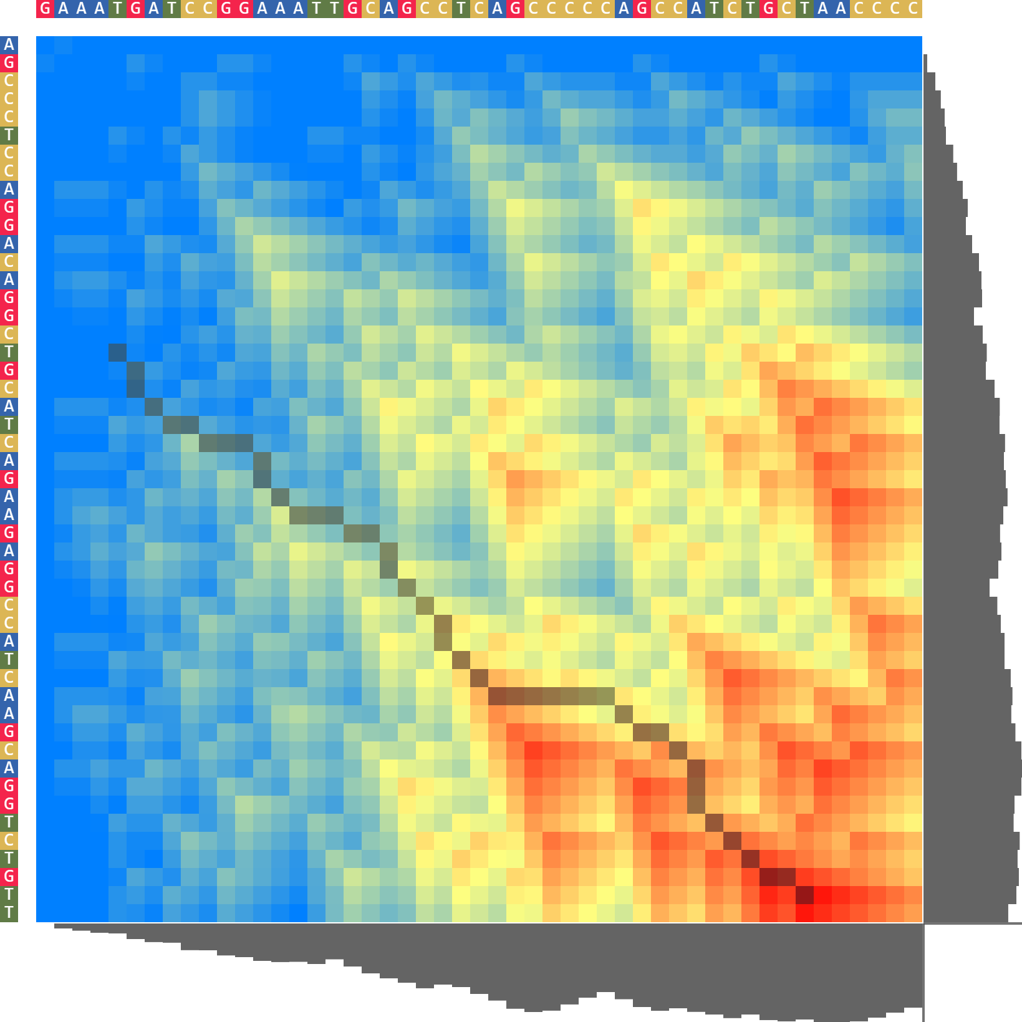
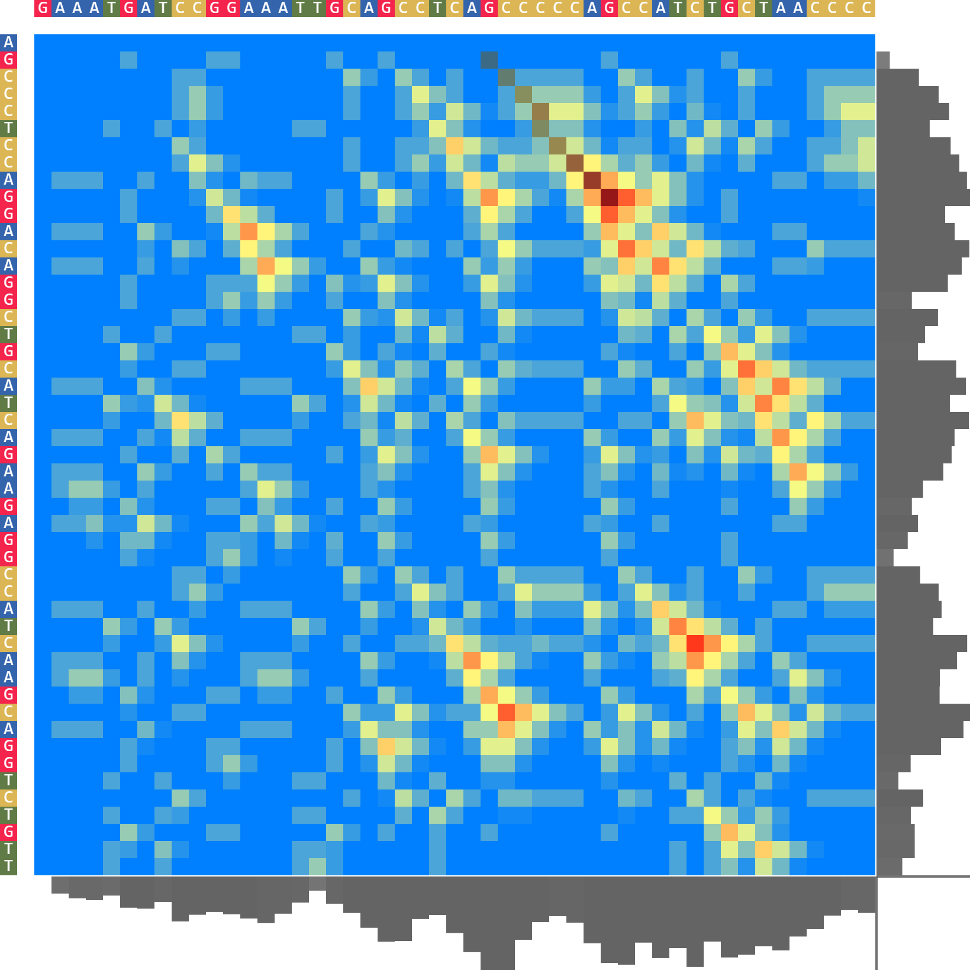
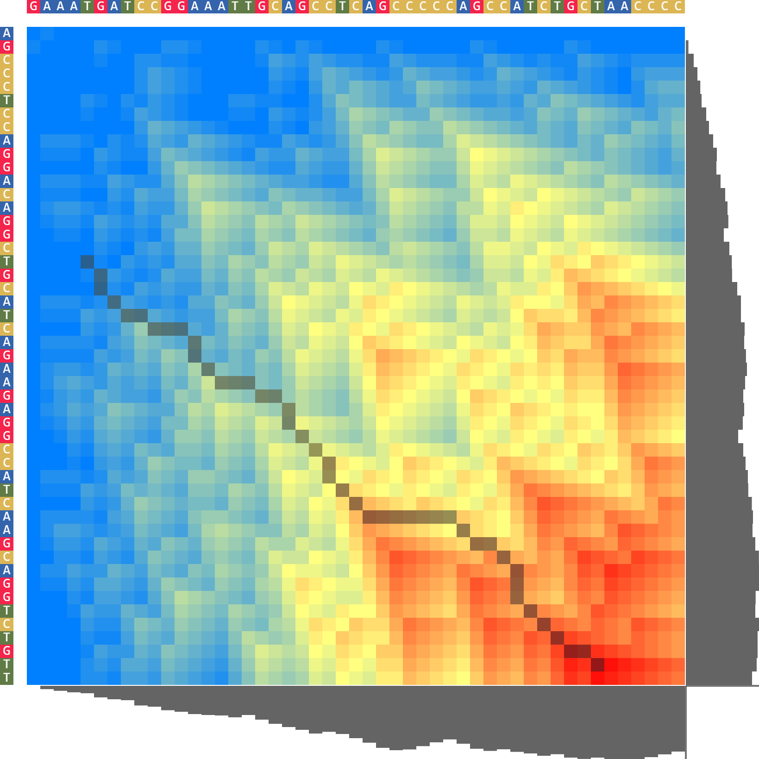
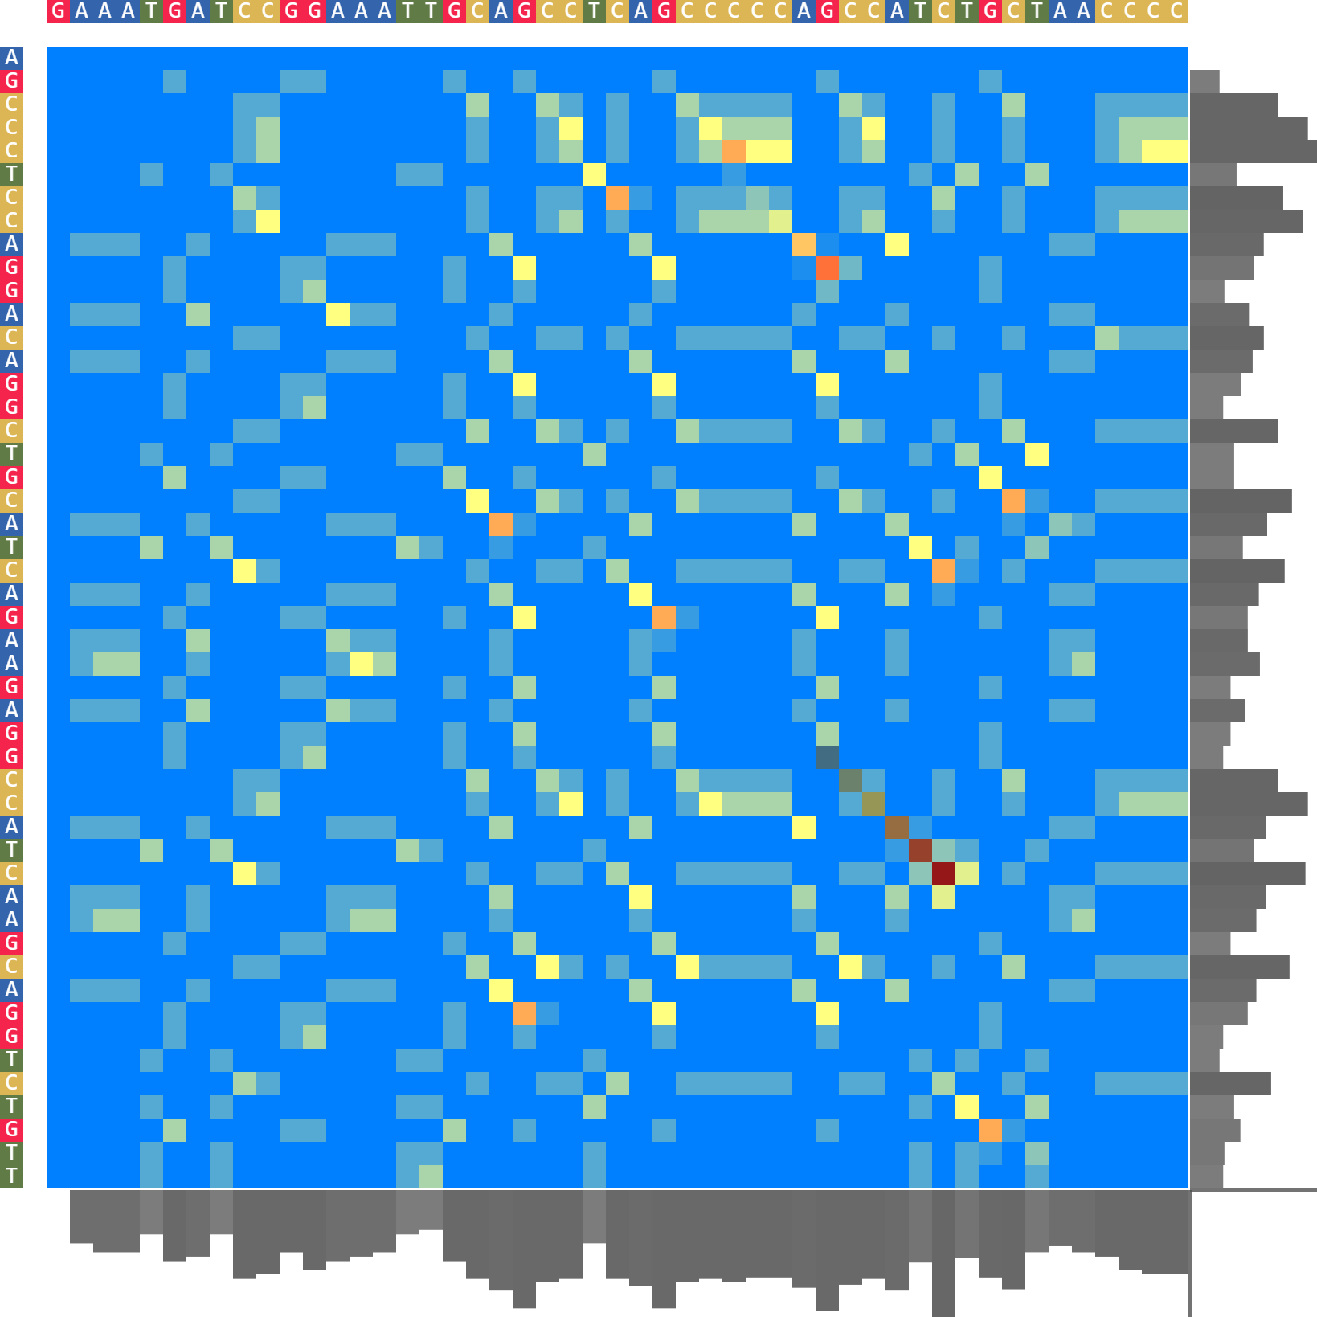
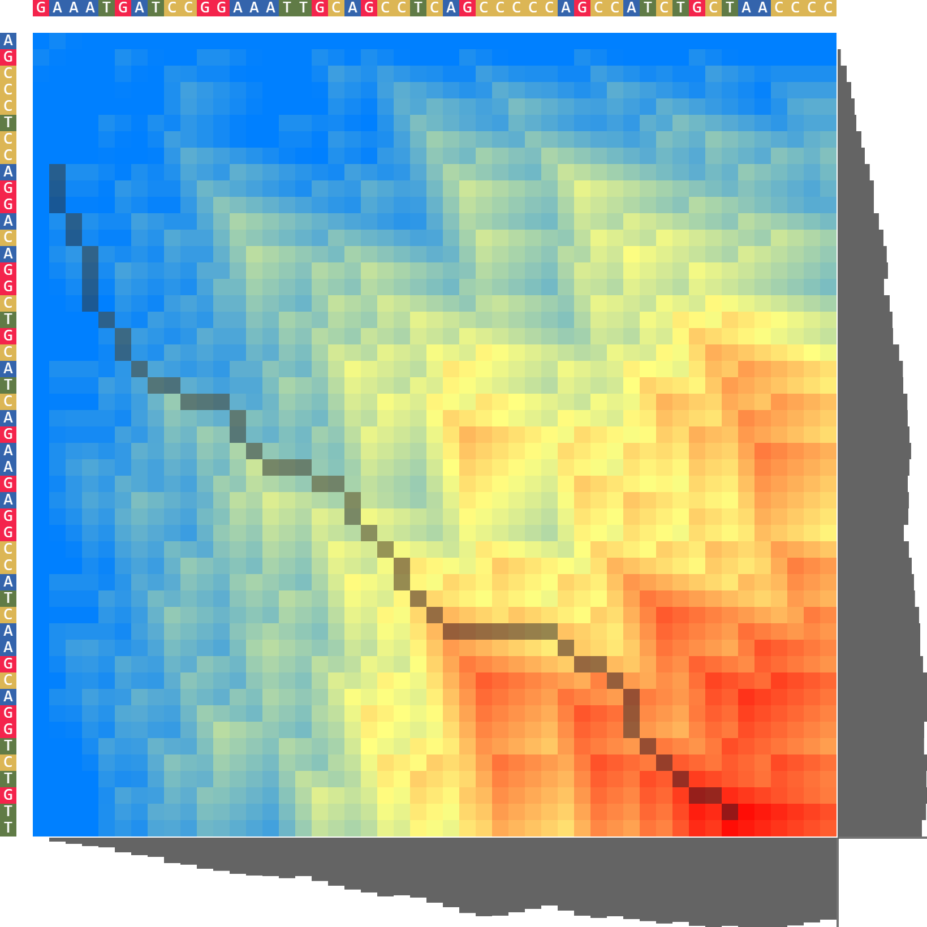
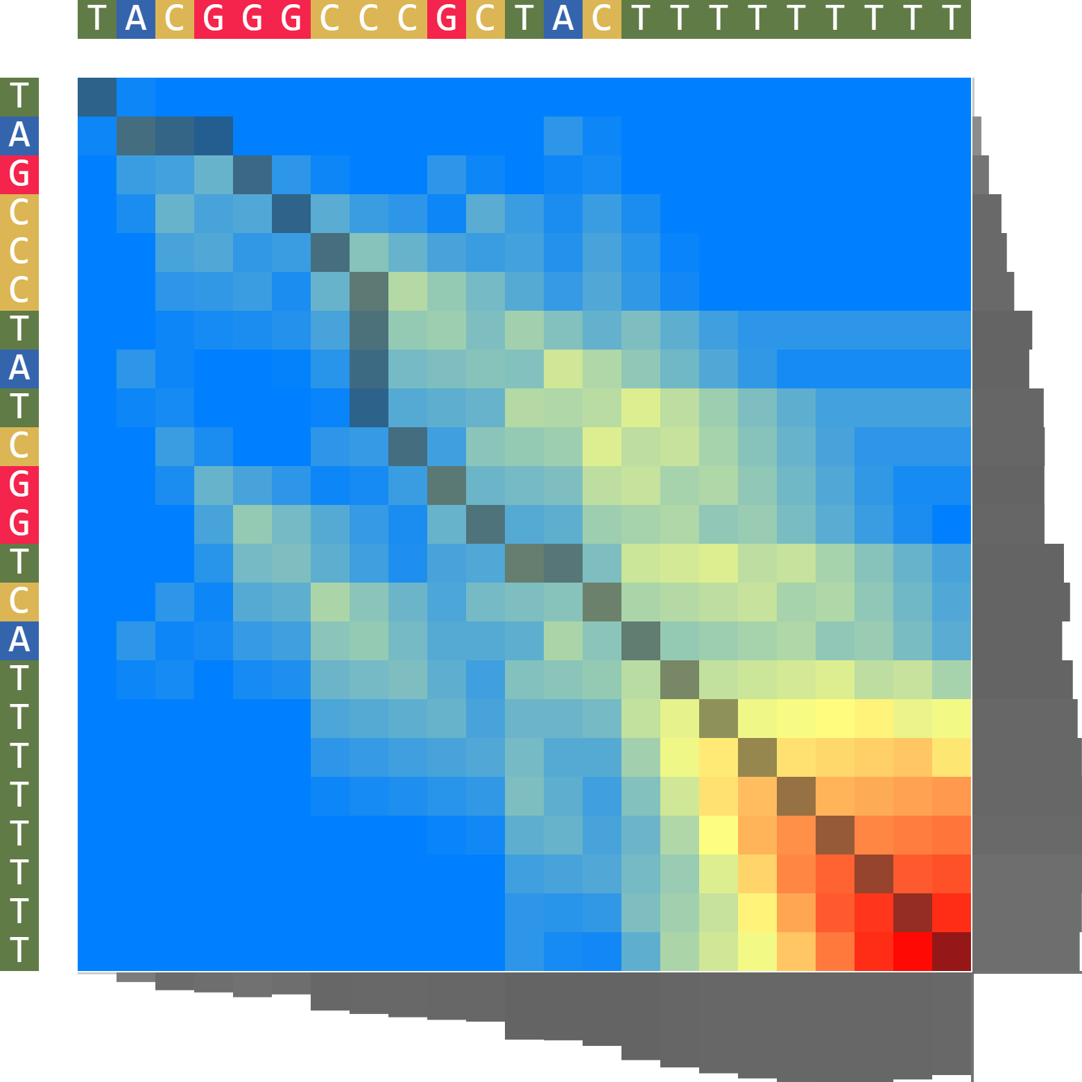
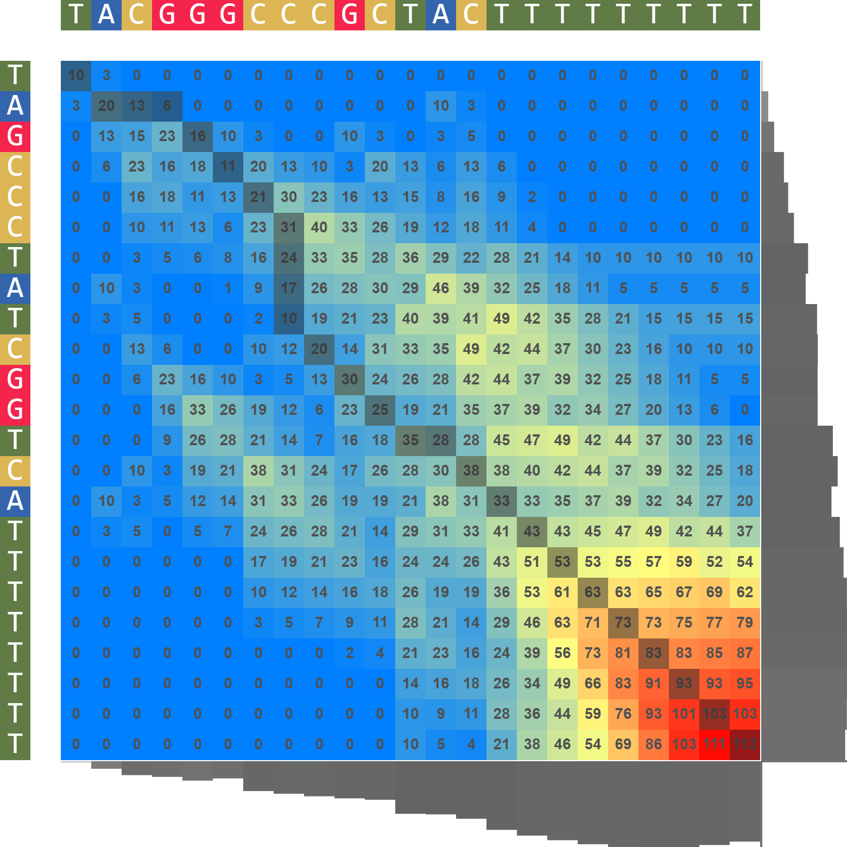
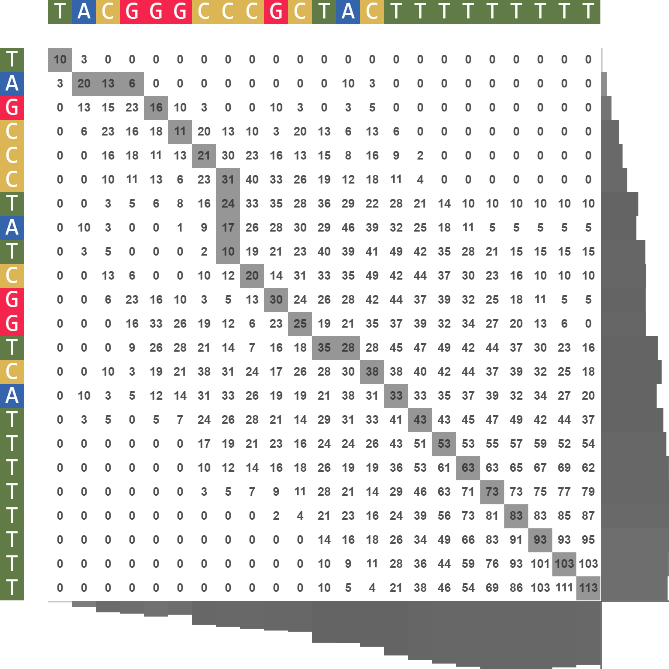
5-[TTTTTAAAAAAAAAAAAAAAATTTTTTAAAAAAAAAAAAAAAAATTTTTT]-3
████
5-[ TTTTTGGGGGGGGGGGGGGGGTTTTTTGGGGGGGGGGGGGGGGGTTTTTT]-3
5-[ TTTTTAAAAAAAAAAAAAAAATTTTTTAAAAAAAAAAAAAAAAATTTTTT]-3
████
5-[TTTTTGGGGGGGGGGGGGGGGTTTTTTGGGGGGGGGGGGGGGGGTTTTTT]-3
5-[ TTTTTAAAAAAAAAAAAAAAATTTTTTAAAAAAAAAAAAAAAAATTTTTT]-3
████
5-[TTTTTGGGGGGGGGGGGGGGGTTTTTTGGGGGGGGGGGGGGGGGTTTTTT]-3
(d)
(e)
5-[TTTTTAAAAAAAAAAAAAAAATTTTTTAAAAAAAAAAAAAAAAATTTTTT]-3
█████
5-[TTTTTGGGGGGGGGGGGGGGGTTTTTTGGGGGGGGGGGGGGGGGTTTTTT]-3
5-[TTTTTAAAAAAAAAAAAAAAATTTTTTAAAAAAAAAAAAAAAAATTTTTT]-3
██████
5-[TTTTTGGGGGGGGGGGGGGGGTTTTTTGGGGGGGGGGGGGGGGGTTTTTT]-3
(i)
(c)
┏ 1b
5-[AGCCCTCCAGGACAGGCTGCAT─C──AGAA──G─AGGCCATCA──────AG─CAGGTCTG─TT]-3
█ █ █ ██ ██ █ █ ██ █ █ ███ ███ ██ ██ ████ █
5-[ GA──A─A───TG─ATCCGGA─AATTGCA─GCC─TCAGCCCCCAGCCA──TCTGCTAACCCC]-3
┗ 1b
(f)
5-[TTTTTAAAAAAAAAAAAAAAATTTTTTAAAAAAAAAAAAAAAAATTTTTT]-3
██████
5-[TTTTTGGGGGGGGGGGGGGGGTTTTTTGGGGGGGGGGGGGGGGGTTTTTT]-3
5-[TTTTTAAAAAAAAAAAAAAAATTTTTTAAAAAAAAAAAAAAAAATTTTTT]-3
██████
5-[ TTTTTGGGGGGGGGGGGGGGGTTTTTTGGGGGGGGGGGGGGGGGTTTTTT]-3
5-[TTTTTAAAAAAAAAAAAAAAATTTTTTAAAAAAAAAAAAAAAAATTTTTT]-3
████
5-[ TTTTTGGGGGGGGGGGGGGGGTTTTTTGGGGGGGGGGGGGGGGGTTTTTT]-3
(b)
(g)
5-[TA──GCCCTATCGGT─CATTTTTTTT]-3
██ █=██ ██=█ █=████████
5-[TACGGGCC───CGCTACTTTTTTTTT]-3
5-[ TTTTTAAAAAAAAAAAAAAAATTTTTTAAAAAAAAAAAAAAAAATTTTTT]-3
██████
5-[TTTTTGGGGGGGGGGGGGGGGTTTTTTGGGGGGGGGGGGGGGGGTTTTTT]-3
(a)
(h)
(j)
(k)
(l)

Slide 2


Alignment parameters and the significance of islands
Alignment parameters and the significance of islands. (a-h) Indicates the change of the values of the parameters and the real time changes visually perceived on the surface of the heatmap. The alignment configuration is shown to the right of the eight successive heatmaps in an upright position. (i) shows a direct association between the islands on the score matrix and the alignment configuration. It also suggests the possibility of novel image encoding strategies (j-l) Indicates the transition from colors to their associated values by maximizing the transparency of the heatmap.
Cite this work as:
Paul A. Gagniuc. Algorithms in Bioinformatics: Theory and Implementation. John Wiley & Sons, Hoboken, NJ, USA, 2021, ISBN: 9781119697961.

